Slide 1


Travel Portal

Slide 2

Agenda
1.System functionality.
2.Application architecture.
3.Database overview.
4.Server side overview.
5.Client side overview.

Slide 3
System functionality
Взаимодействие с картами Google;
Создание и работа с метками на карте;
Авторизация через соц-сети Google+ и Facebook;
Привилегии юзеров
Some FR

Slide 4
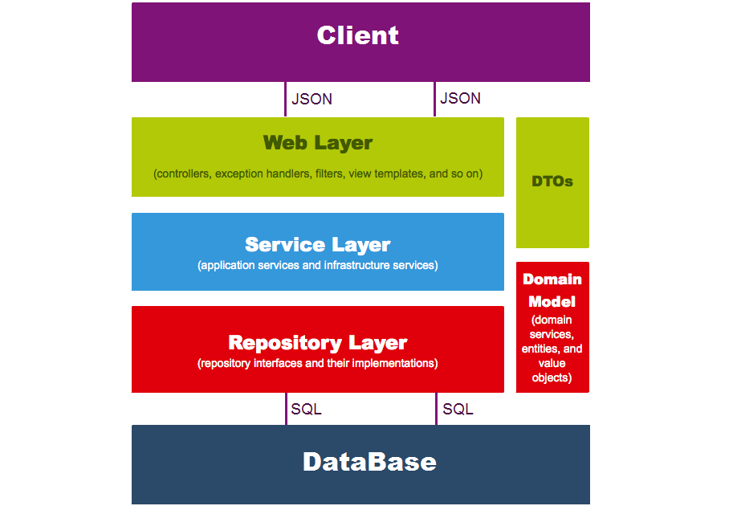
Simple application architecture model

Slide 5
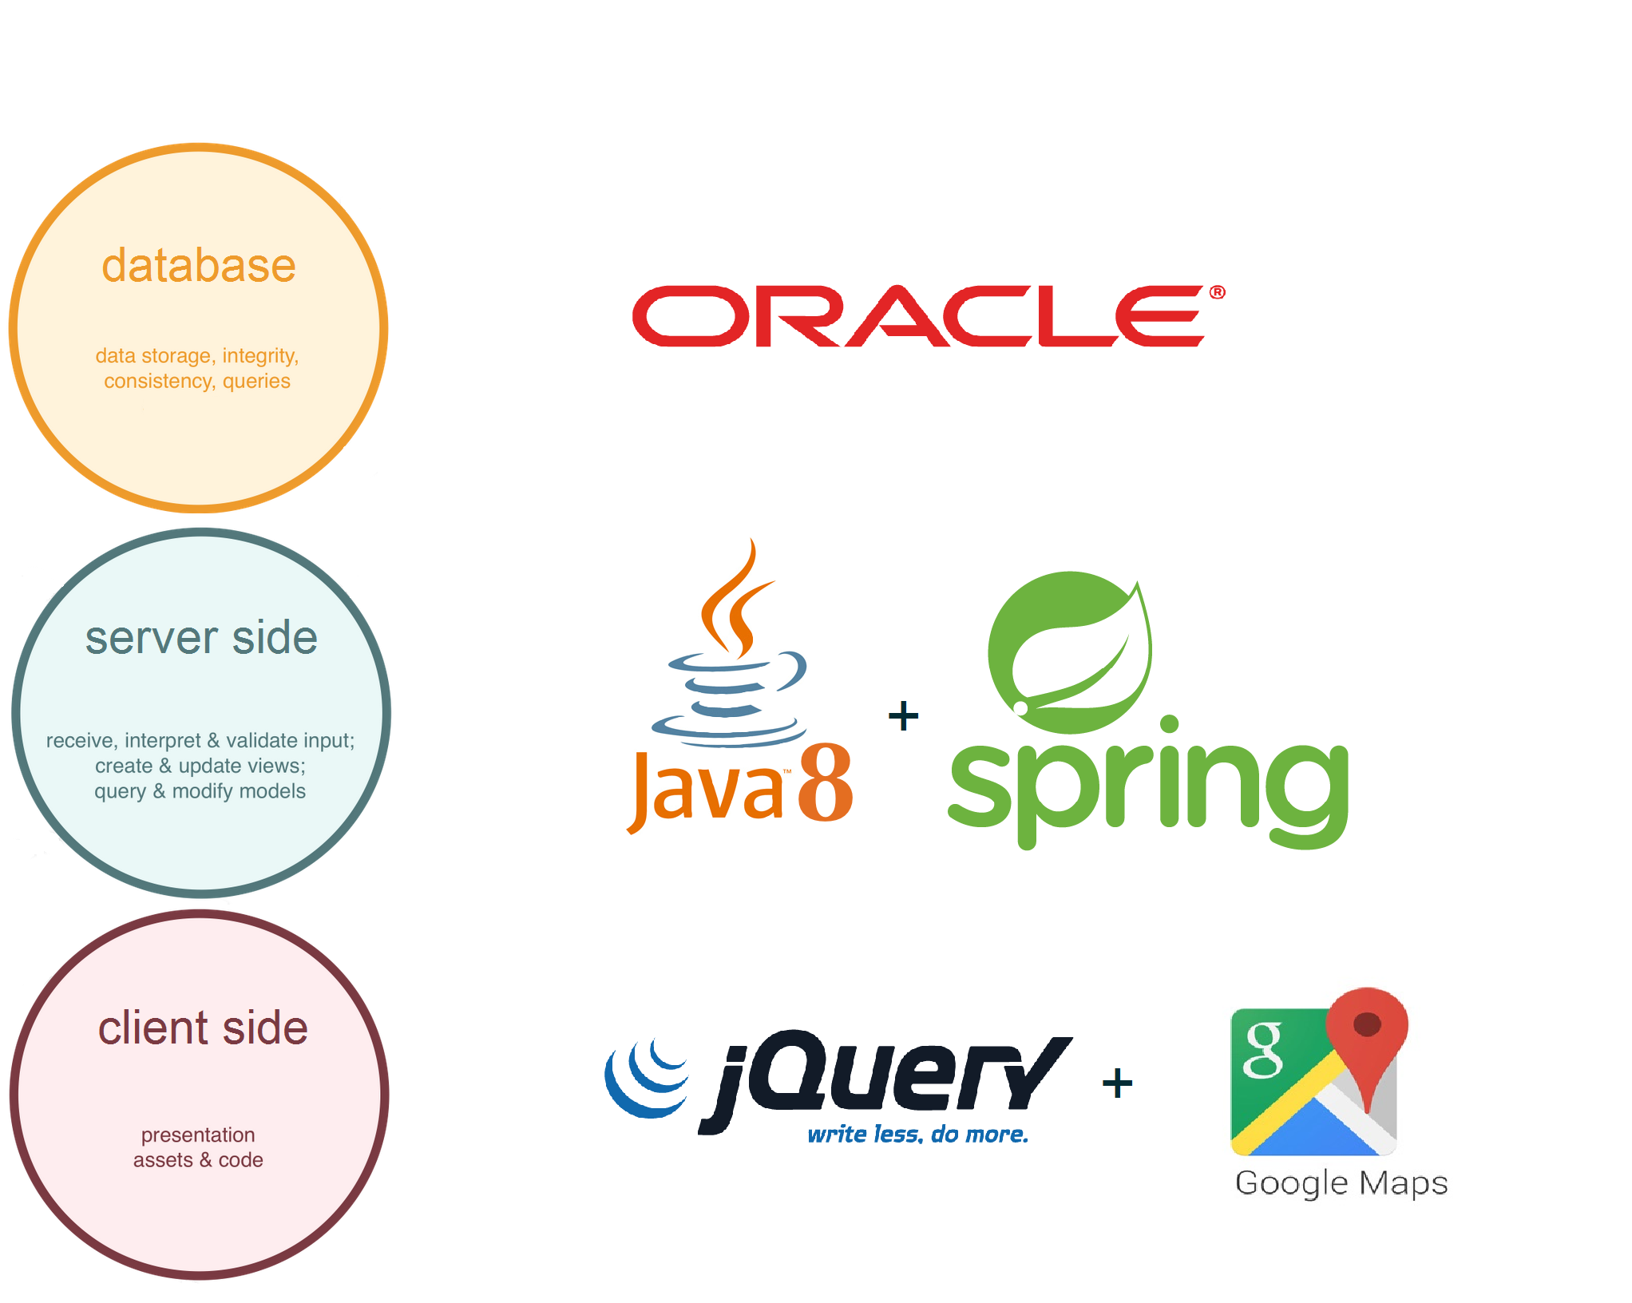
Used technologies

Slide 6
Database overview
Oracle database;
Object model;
Relational model;

Slide 7
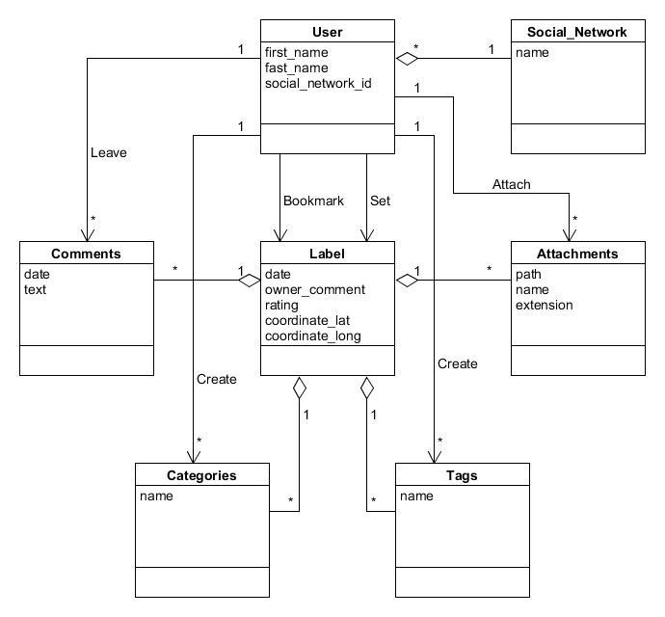
Object model

Slide 8
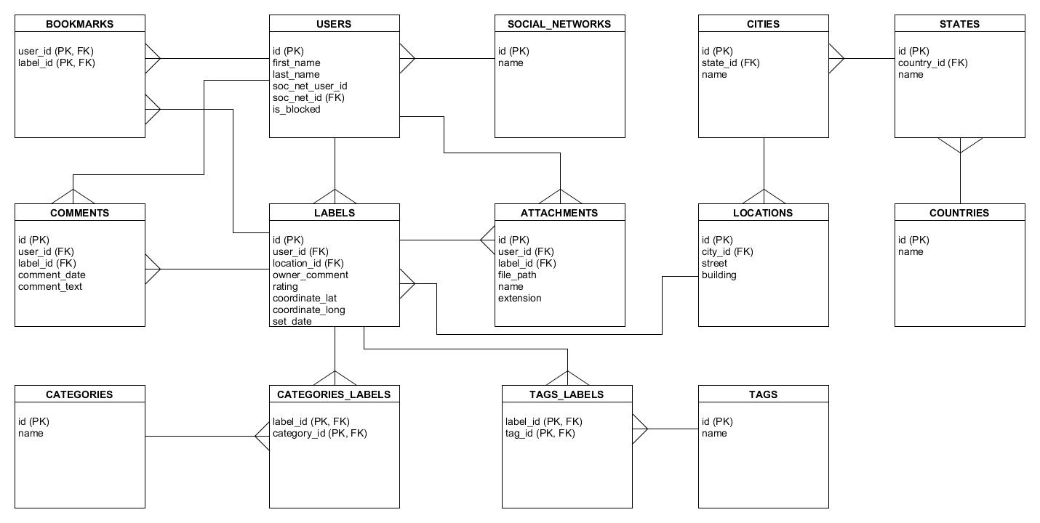
Relational model

Slide 9
Server side overview
Maven modules;
Main functions lifecycles;
Security;
Web Architecture;

Slide 10

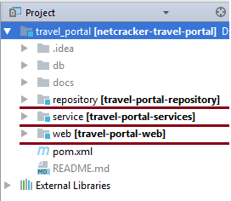
Each Maven module represent its own layer.

Slide 11
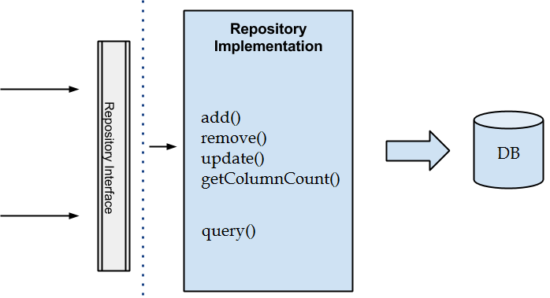

Repository layer
Repository pattern for CRUD.
Specification classes for complicated queries.

Slide 12

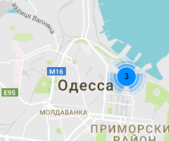
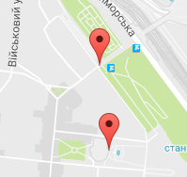

Service layer
View labels on map lifecycle.
JSON
с координатами
Приблизить
MapController
JSON
метки
Список меток
Координаты
LabelService
Метки в полигоне
Label
Repository
Вычисление полигона
Поиск меток в полигоне
Запрос на метки

Slide 13
Service layer
View labels on map lifecycle.
1. Вычисление полигона на основе 2-ух точек.
В(x2, y2)
А(x1, y1)
2. Запрос на точки внутри полигона.
Label P (x3, y3)
If (x1 < x3 < x2 && y1 < y3 < y2)
//TODO описать алгоритм UML
3. Конвертация сущностей в DTO.

Slide 14
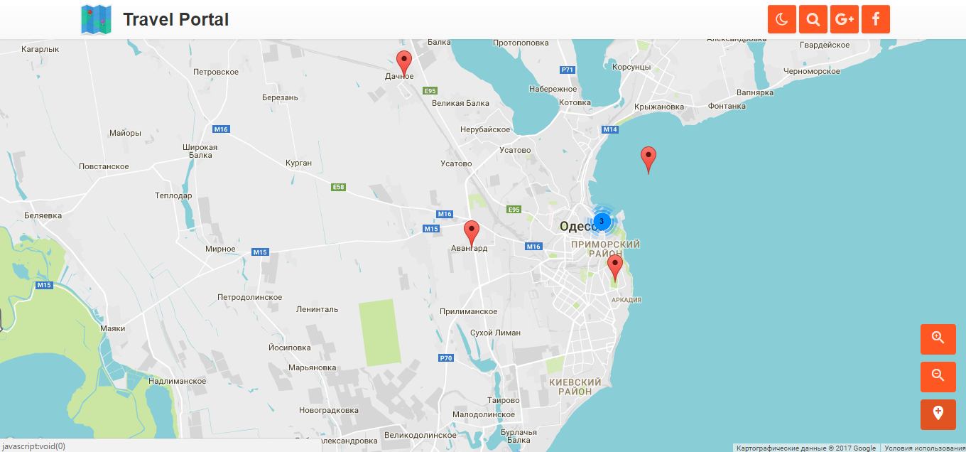
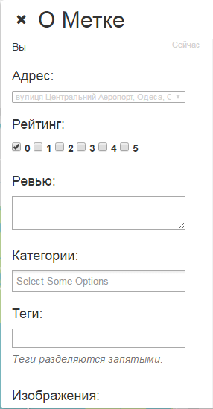
Service layer
Add label lifecycle.

Slide 15
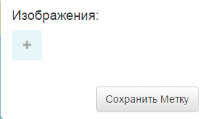
Service layer
Add label lifecycle.

Slide 16
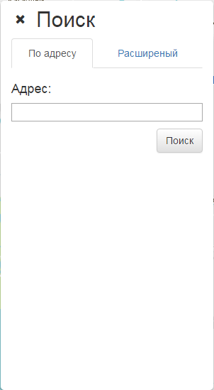
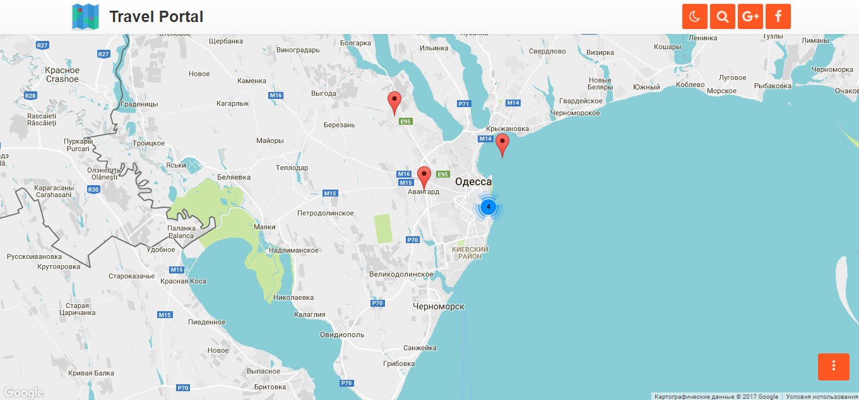
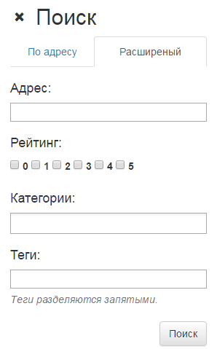
Service layer
Find/filtrate labels.

Slide 17
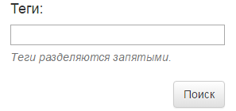
Service layer
Find/filtrate labels.

Slide 18
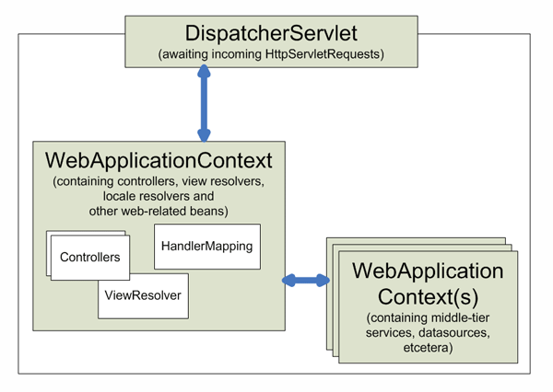
Web layer
Controllers Description.

Slide 19
Security and aunthentication.

Slide 20
Client side overview
Architecture
Used Technologies
...

Slide 21
Architecture
Event Listeners (Hooks)
Window Drawer
Services
TPL
Third Party Libraries
Map Controller
Window Controller
Views
Google Maps API (+Geocoding)
SERVER

Slide 22
Used Technologies / Modules
TypeScript - programming language that extends JS
Require.JS - async JS dependency injector
jQuery - frontend JS framework
Bootstrap - CSS styling framework
MMenu (jQuery Module) - mobile style navigation
Toast (jQuery Module) - information popups
Validate (jQuery Module) - form validation
FeatherLight (jQuery Module) - image gallery

Slide 23


Why TypeScript
and what is Require.JS?
TypeScript - programming language that brings you optional static type-checking along with the latest ECMAScript features.
Require.JS - async JS dependency injector that loads modules by importing scripts using special code in the top of the module. It is very usefull when TypeScript is compiles with “--module AMD” parameter.

Slide 24
Why jQuery?

Slide 25
Why Bootstrap?

Slide 26
Why Bootstrap?

